Slide 1

Genetic parameters of disease in growing pigs under a polymicrobial natural disease challenge
Usamah Kabuye
PhD student | Genetics and Genomics | Dr. Jack Dekkers’ lab
Animal Science Department

Slide 2



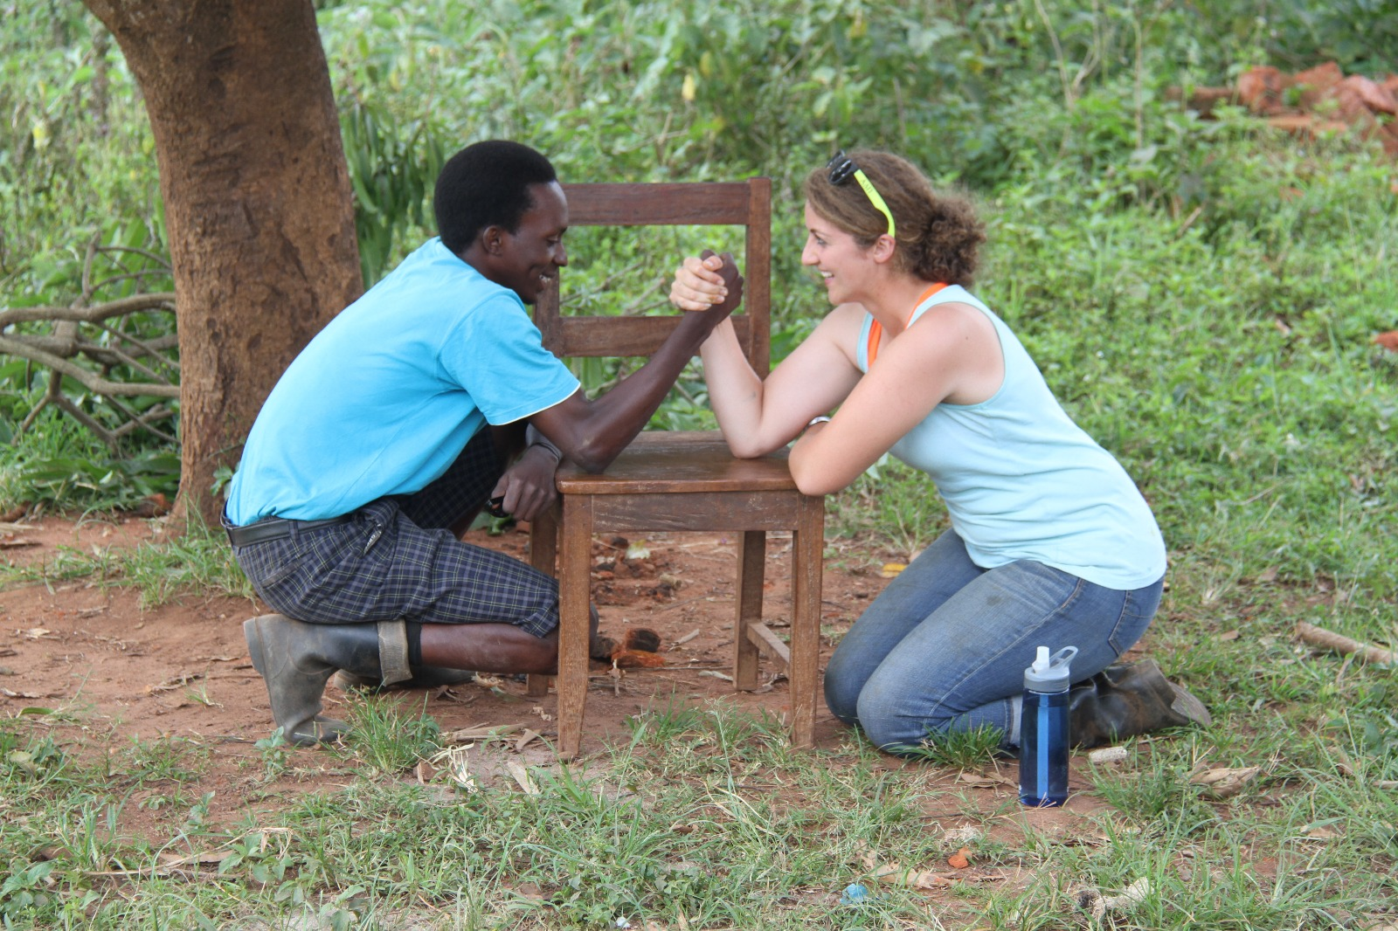


Department of Animal Science

Slide 3
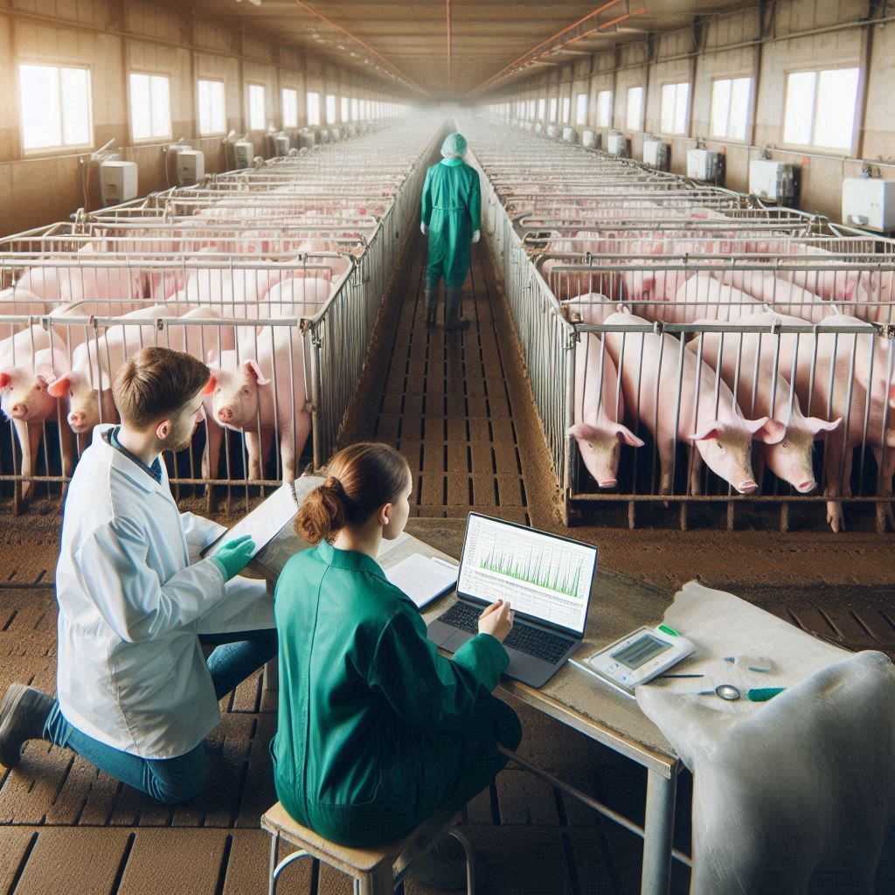
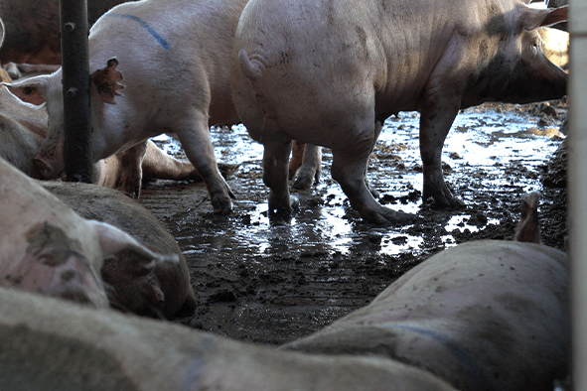
Introduction
Selection in most pig breeding programs is conducted in high-health nucleus herds while pigs typically encounter multiple pathogens in commercial herds
Knowledge gap of genetic parameters of disease related traits of growing pigs under a polymicrobial disease challenge still exists
Genetic parameters e.g. litter effects, heritability, genetic correlation between traits are key to strategic animal breeding
Objective: Estimate genetic parameters for individual health treatments and mortality associated with specific diseases of growing pigs under a severe natural polymicrobial disease challenge
Department of Animal Science
Notes:
Selection in most pig breeding programs is conducted in high-health nucleus herds, while pigs typically encounter multiple pathogens in commercial herds.
Knowledge of genetic parameters of disease related traits of growing pigs under a polymicrobial disease challenge is still limited.
Genetic parameters are key to animal breeding as they enable breeders to select animals with desirable traits to enhance performance, disease resilience and economic value over time.
Understanding genetic parameters is not just important—it is indispensable in animal breeding, serving as the cornerstone for any meaningful genetic improvement in traits that are vital for economic viability, animal health, and productivity.
Understanding genetic parameters like heritability, genetic correlations, and variance components is essential for effective animal breeding programs, as it allows breeders to strategically select animals with the most desirable genetic traits to improve production, health, and economic value across generations.
In short, genetic parameters provide the roadmap for breeding programs, ensuring that decisions are not just intuitive but scientifically informed. That’s why they matter—and why we care.

Slide 4

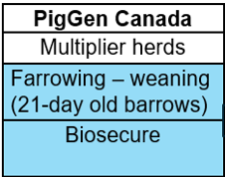
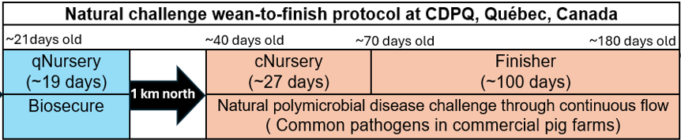
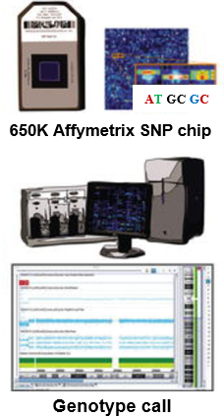
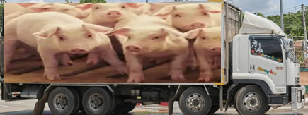
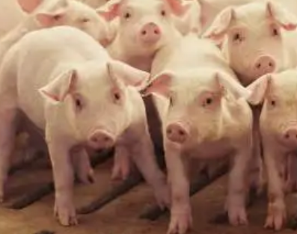
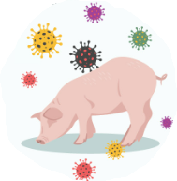
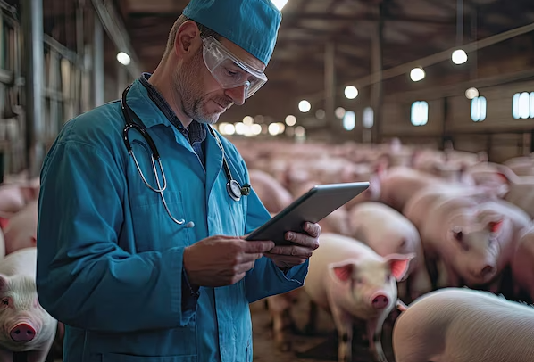
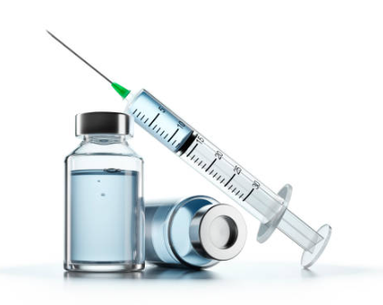
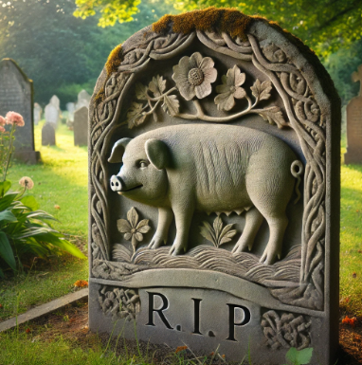
Materials and methods
Birth
A three-phase natural polymicrobial disease challenge (see Putz et al.,2019)
Weaning
Market
Animals
4,095 Y × LR barrows
66 batches (each ~60 -75 pigs)
Phenotypic data collection
Genotyping
650k Affymetrix Axiom Porcine Genotyping Array
Traits analyzed
Treatment rates (TRR) and Mortalities (MOR)
Estimates: c², h² and r_{g}
Uni- and bi-variate analyses using generalized and linear mixed models with genomic relationships (ASReml 4.2)
Individual health treatments and mortality records categorized as:
Meningitis (ME)
Respiratory distress (RD)
Scours (SC)
Unthriftiness (UNTH)
Other infections (OT)
Model: y_{ijklm} = Batch_{i} + EntryAge_{ijklm} + Pen_{k} + Sow_{ijkl} + Pig(grm)_{ijklm} + e_{ijklm}
Department of Animal Science
Notes:
The following general model was
used in single-trait and bivariate analyses to estimate variance
components and genetic correlations:
yijklm = Batchi + Ageijklm + Penk + Sowijklm + Pig(grm)ijkl + eijklm
(5)
where yijklm is the trait phenotype; Batchi is a fixed batch effect
(i = 1, …, 66); Ageijklm is the covariate of age when the pig entered
the quarantine nursery; Penk is the random effect of pen by batch,
Corresponding to the different phases, with vector Pen ∼ N(0, Iσ2
P),
where σ2
P is the pen variance; uijklm is the random additive genetic
effect, with vector u ∼ N(0, Gσ2
A), where G is the genomic
relationship matrix and σ2
A is the additive genetic variance; litterl
is the
random litter environmental effect, with vector litter ∼ N(0, Iσ2
l ),
where σ2
l is the litter variance; and eijklm is the residual effect,
with vector e ∼ N(0, Iσ2
e ), where σ2
e is the residual variance.

Slide 5
Key points
RD TRR and MOR is substantially influenced by genetics, making it a key candidate for genetic selection in both the challenge nursery and finisher.
Litter effects are critical in early life stages though they diminish as the pigs mature.
Selection strategies for improving treatment rate and mortality traits should be balanced to avoid unintended consequences.
Genetic parameters provide the roadmap for breeding programs, ensuring that decisions are not just intuitive but scientifically informed. That’s why they matter—and why we care!
This study considered disease-specific treatment rates and mortality for a large number of pigs under a severe polymicrobial disease challenge and provides valuable information to breed for disease resilience.
Department of Animal Science

Slide 6
Next steps
Genome Wide Association Studies (GWAS)
Gene Set Enrichment Analysis (GSEA)
Identifying candidate genes
Manuscript preparation
Department of Animal Science

Slide 7





Acknowledgements
Major Professor & PI
Dr. Jack Dekkers
POSC:
Dr. Jack Dekkers
Dr. Juan Pedro Steibel
Dr. Austin Putz
Dr. Daniel Linhares
Dr. Chong Wang
Co-authors:
John Harding
Michael Dyck
Frederic Fortin
Graham Plastow
PigGen Canada
Jack Dekkers
Family, friends and colleagues, ABG-Animal Science Department
Funding from Genome Canada, Genome Alberta, Genome Prairie, PigGen Canada, USDA NIFA (2017-67007-26144), and the National Pork Board Survivability Project
Department of Animal Science

